Slide 1



Pitch Deck
Supply Elites
PRESENTATION
Param Sorniya – 21EARAD066
Ishita – 21EARAD040
Kashish Sharma – 21EARAD043

Slide 2
01
02
03
Problem 1
Problem 2
Problem 3
Supply chains often suffer from inefficiencies, and lack of trust among stakeholders.
Traditional supply chain management systems struggle to provide real-time visibility, leading to delays, errors, and even fraudulent activities
Manual record-keeping processes are prone to inaccuracies and tampering.

Slide 3
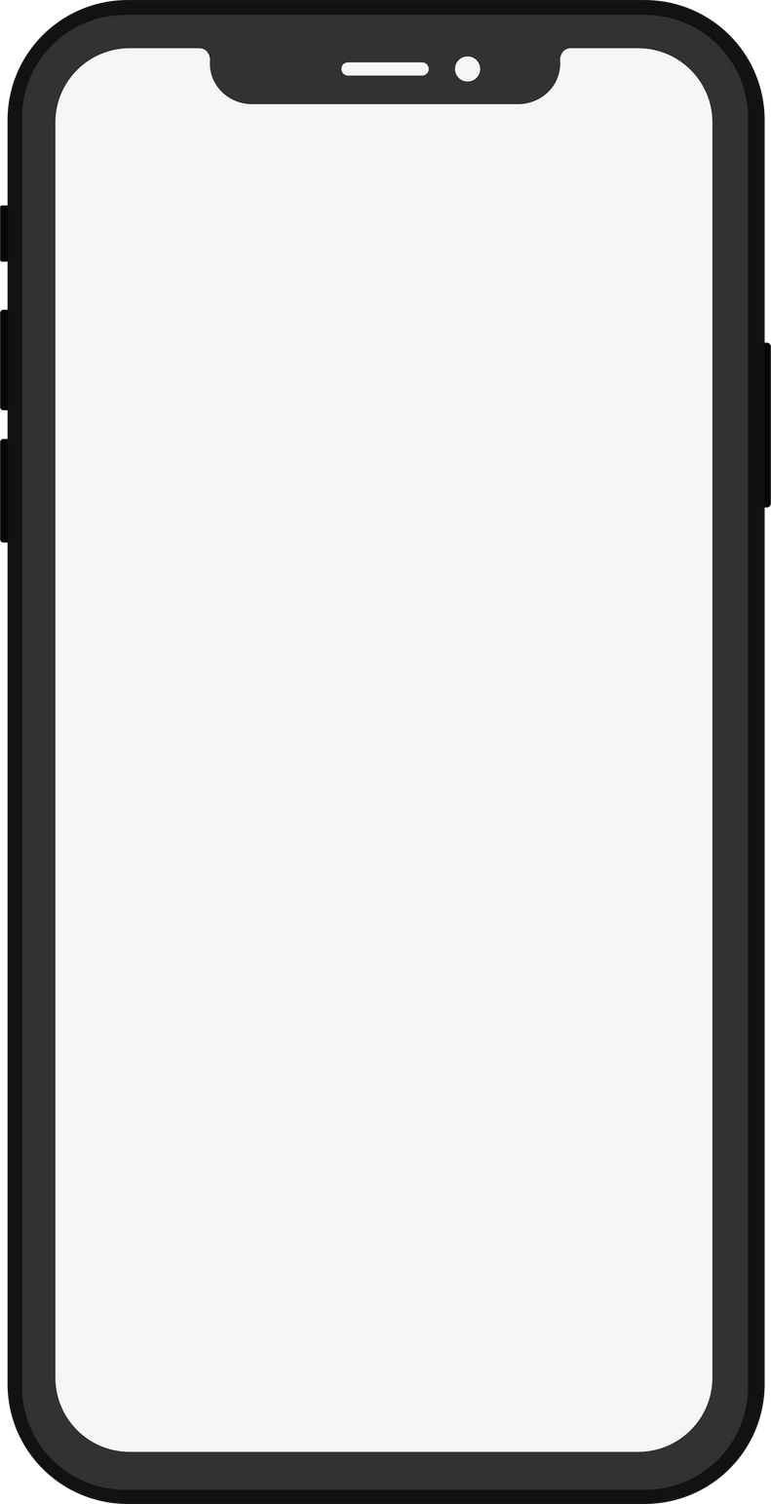

Solution 1
01
My idea is based on Blockchain where we develop a secure and transparent record keeping system for the Supply Chain Management which increases trust and accountability where buyer and seller track the Supply chain
Solution 2
02
Our business could offer a blockchain-based platform that helps companies track goods & practices throughout the supply chain. By integrating sensors, smart contracts, & tokenized incentives
Solution 3
Brand Name
03
Our solution creates transparency and effectivenesss in the supply chain ensuring trust .

Slide 4
Key
Features
Feature 1
Enhanced Transparency and Traceability:
Blockchain provides an immutable ledger where every step in the supply chain is recorded. This allows participants to track the movement of goods, materials, and documents in real-time, increasing transparency and visibility.
Feature 2
Feature 3
Feature 4
Automated Smart Contracts:
These self-executing contracts automate specific actions based on predefined conditions. This eliminates the need for manual processes and paperwork, streamlining workflows and reducing administrative costs.
Improved Security and Reduced Fraud:
Blockchain's cryptography and distributed ledger technology make it tamper-proof, preventing unauthorized access and manipulation of data. This significantly reduces the risk of fraud
.
Streamlined Logistics and Inventory Management:
Blockchain's real-time tracking capabilities and automated processes contribute to optimized logistics and inventory management:

Slide 5
Target User
User 1
User 2
User 3
->Manufacturer
->Supplier
->Distributer
->Retailer
->Social Organization
->Auditors
-> Government Authorities
->Financial Institutions

Slide 6




Competitive Analysis
Your main Competitors and their products, how are they different and what value do you provide to your customers?
->Walmart
->Modum
->Shipchain
->Ambrosus
Our Competitor mainly focus on specifc section
We are ot going with any specific field
Our project will mainly focus on complete distribution System , where multiple layers are present
Supply Chain Processes

Slide 7
Financial Assessment
->Revenue Streams
->Development Cost
->Market Analysis
->Monitoring and Evaluation Cost

Slide 8
Revenue Model
A revenue model is a framework for generating financial income. It identifies which revenue source to pursue, what value to offer, how to price the value, and who pays for the value. It is a key component of a company's business model.
Subscription-Based Model: Customers pay a recurring subscription fee to access and use the blockchain supply chain platform. The subscription fee can be based on factors such as the number of users, volume of transactions, or level of features and support provided.
Per-Transaction Fees: The company charges a fee for each transaction processed on the blockchain platform. This model is often suitable for businesses that have a high volume of transactions or require a pay-as-you-go pricing structure.
Licensing Fees: Companies may charge licensing fees for the use of their blockchain supply chain software. This can involve one-time upfront payments or ongoing royalties based on usage.

Slide 9




Future Roadmap
What are your next steps and goals? How much support do you need from investors and what will it get you?
Prototype
Launch
V2.0
V2.2
Q1 2024
Q4 2024
Q1 2025
Q4 2025

Slide 10
Thank You
Organized by ACEIT E-Cell Club
Supported by - Arya Incubation Cell
Arya College of Engineering & I.T

